Slide 1

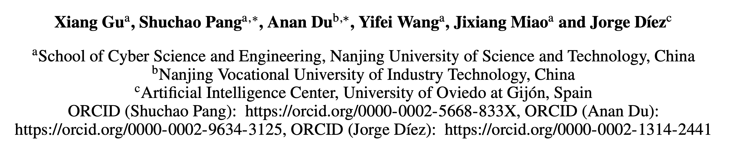

Dynamic Multimodal Prompt Tuning:
Boost Few-shot Learning with VLM-Guided Point Cloud Models
Proxy : XXX

Slide 2
Outline
Background
Motivations
Overview of approach
Dynamic Knowledge Collector
Multimodal Prompt Generator
Experimental Results & Analysis
Conclusion

Slide 3

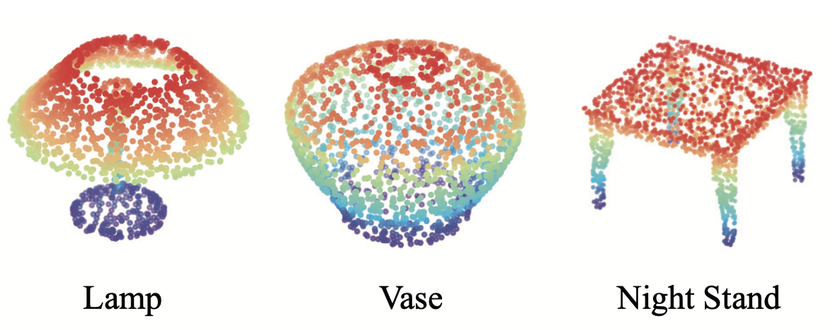
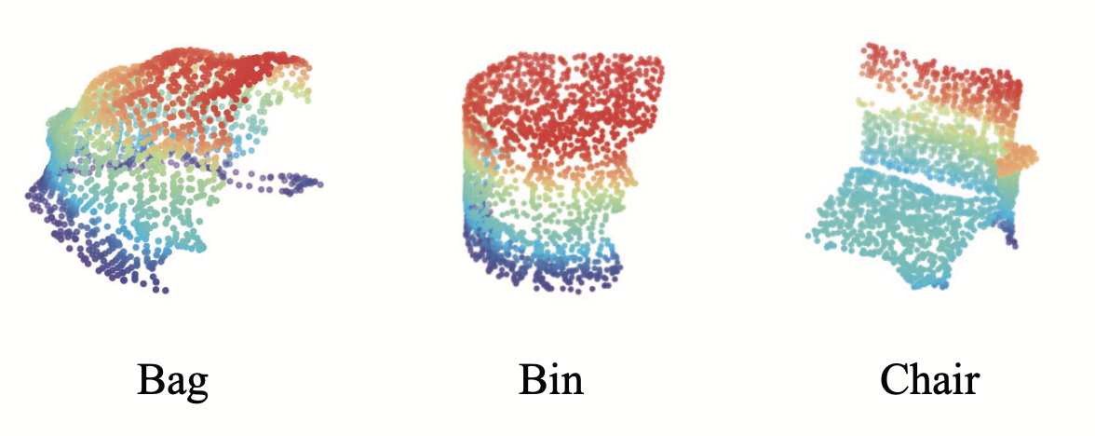
Background
Due to the cost and effort involved in collecting and labeling high-quality 3D samples, obtaining sufficient datasets for 3D point cloud tasks is challenging .
Pre-trained VLM-Guided point cloud models, containing abundant knowledge，can compensate for the scarcity of training data, potentially leading to very good performance.
ModelNet40
ScanObjectNN
Figure: What 3D point cloud dataset looks like

Slide 4
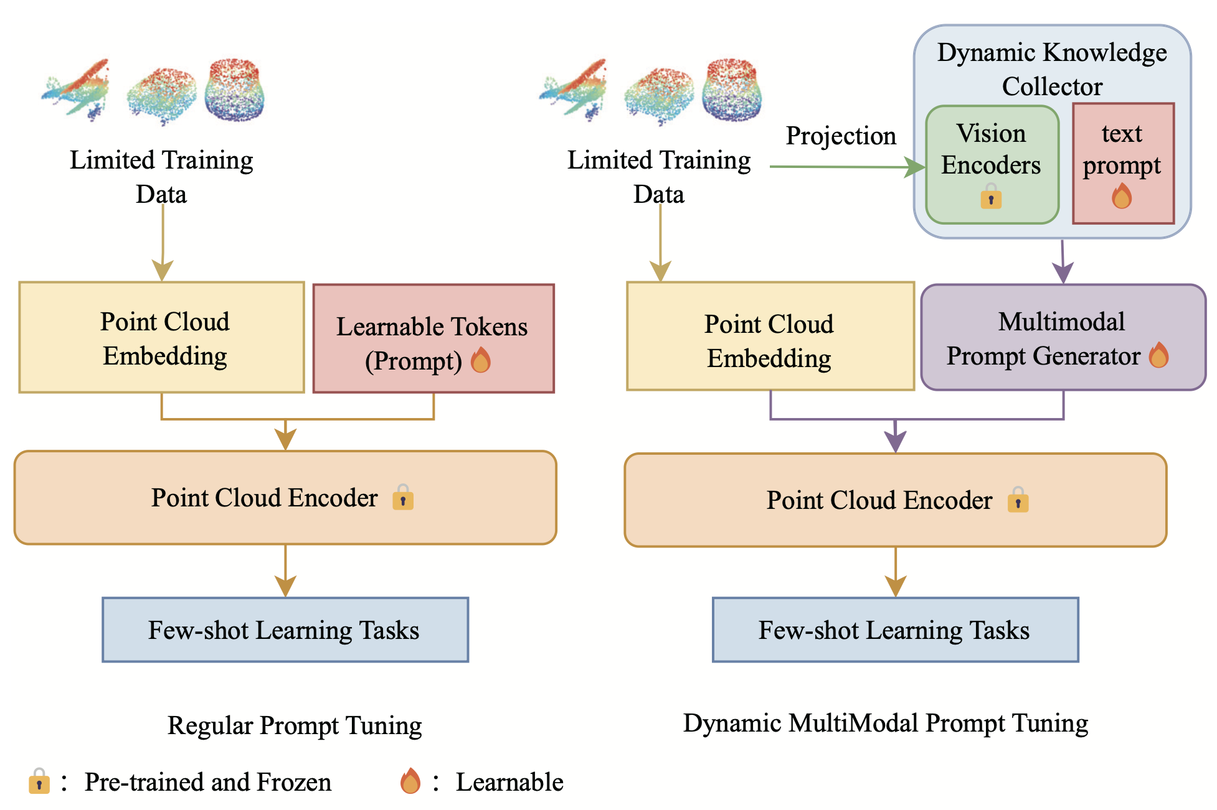
Motivation --VLM-Guided Point Cloud Model
We observed that
Few-shot Learning: Data is scarce.
Fine-tuning VLM-Guided Point Cloud Models: High Data and Computational Demands
To address this
We aim to propose a prompt-based PEFT method to efficiently and dynamically facilitate multimodal information, fully leveraging the knowledge hidden in data.
Figure : Comparison with regular prompt tuning method

Slide 5
Motivation -- Few-shot Learning in Point Cloud Model
We observed that
Current methods : Prompts at a single modality.
Prompting a single encoder may encounter difficulties when the pre-trained encoder lacks knowledge about the target data.
To address this
we aim to combine the rich knowledge from pre-trained encoders across different modalities and utilize additional information to generate a multimodal prompt.
Figure: Comparison with regular prompt tuning method

Slide 6
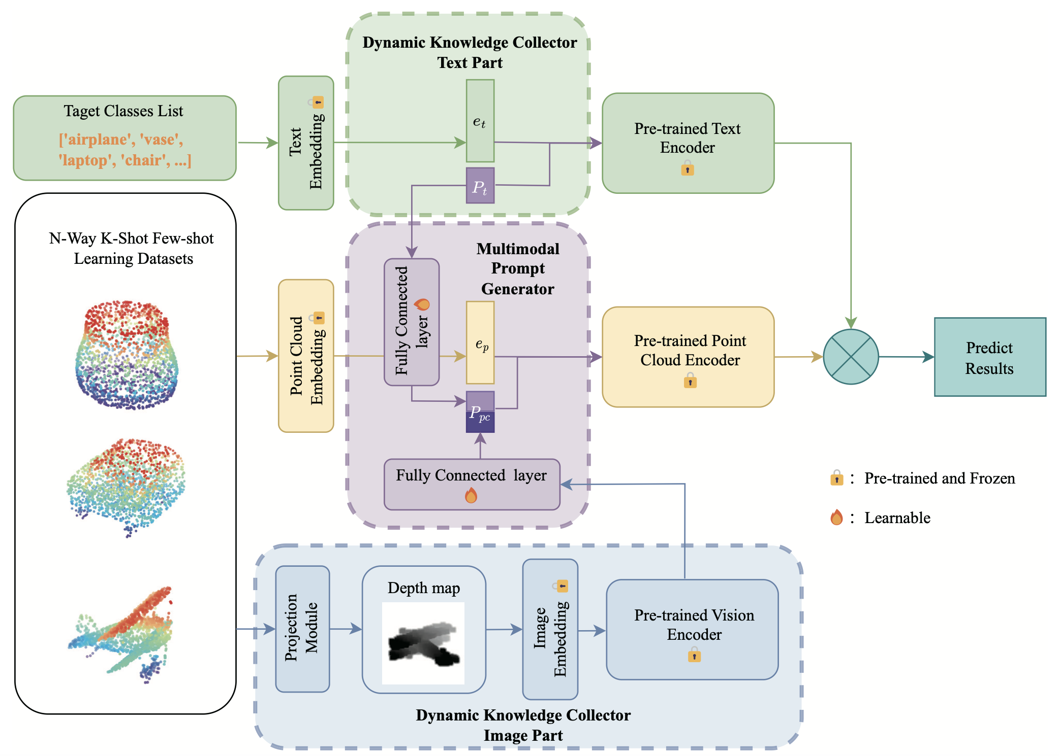
Overview of approach -- Dynamic Multimodal Prompt Tuning (DMMPT)
We propose DMMPT, a new prompt tuning method for VLM-Guided point cloud models for few-shot learning.
By introducing a dynamic knowledge collector capable of gathering knowledge from various modalities and creating a multimodal prompt generator to enhance knowledge sharing, we manage to fully absorb information across modalities and boost pre-trained point cloud models in few-shot learning tasks.
Figure: Pipeline

Slide 7
Overview of approach -- Dynamic Knowledge Collector
A dynamic knowledge collector is introduced to gather information across encoders of different modalities. It contains two parts: the text part and the image part.
Text Part
Image Part

Slide 8
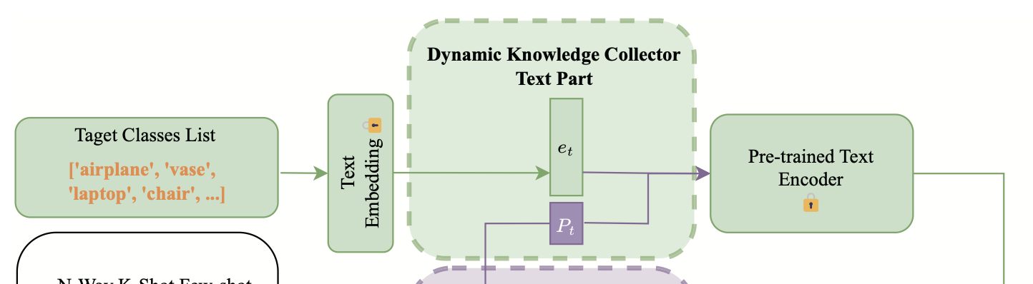
Overview of approach -- Dynamic Knowledge Collector Text Part
In the text branch, we initialize the learnable text prompt tokens. This text prompt conducts learnable prompt tuning in the text branch, enabling it to absorb task-related knowledge.
Subsequently, this acquired knowledge will be integrated into the multimodal prompt generator, guiding the pre-trained point cloud encoder to specific few-shot learning tasks.

Slide 9
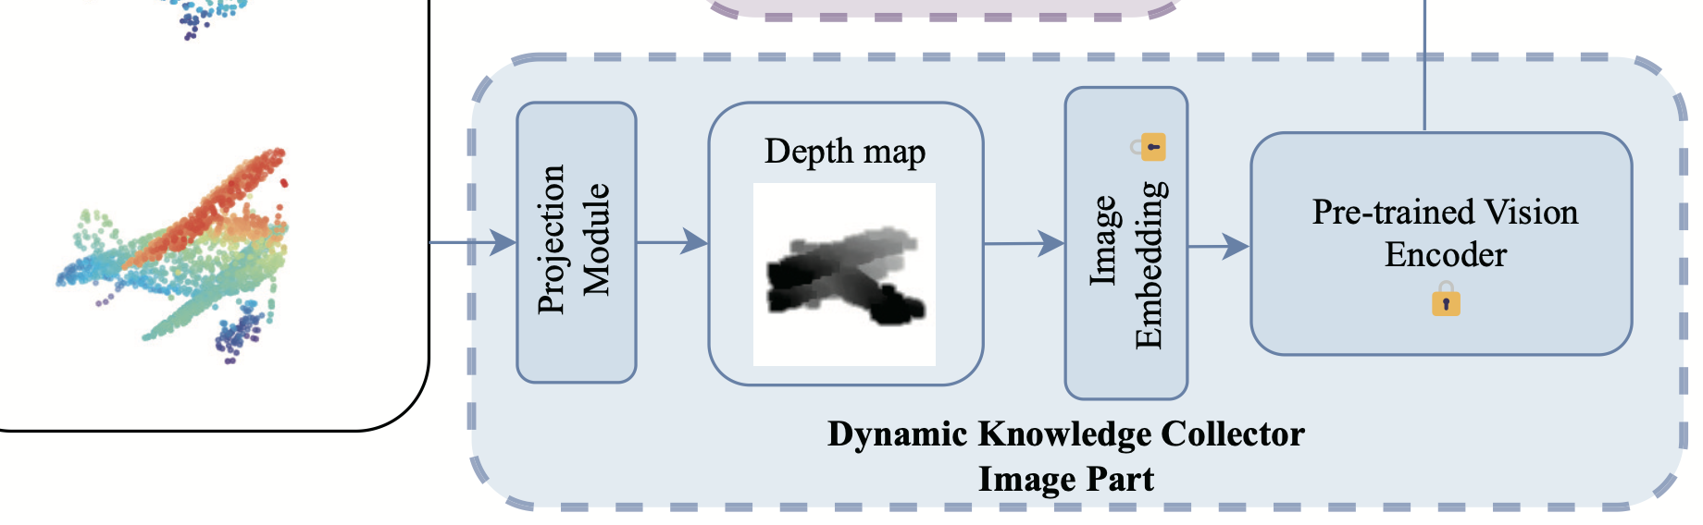
Overview of approach -- Dynamic Knowledge Collector Text Part
In the image branch, considering the flexibility of images, our purpose is to dynamically leverage image information into the point cloud branch to enhance the generation of point prompts by its additional data-related knowledge.
we utilize the image features processed by a pre-trained vision encoder and directly use it as a part of inputs for point prompt generation.

Slide 10
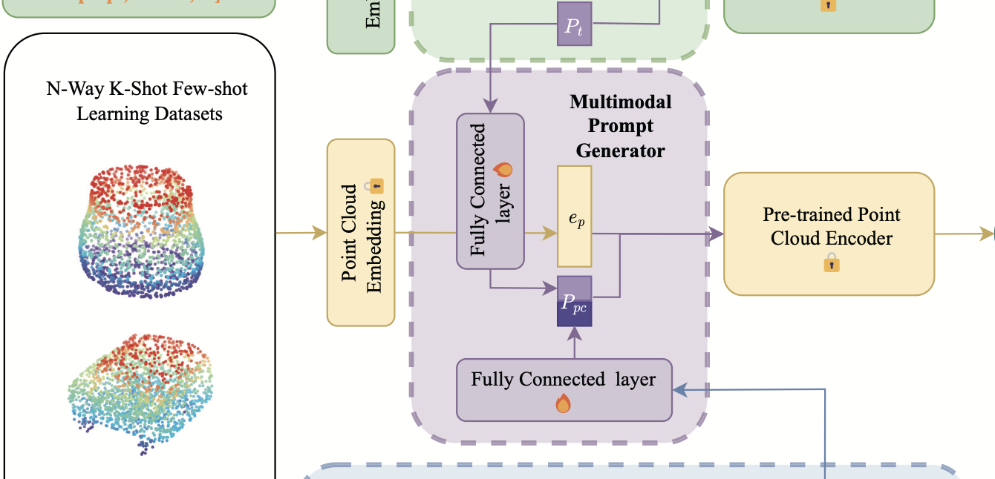
Overview of approach -- Dynamic Multimodal Prompt Generation
Learnable text prompt token contains task-related knowledge
we build a prompt generation module in the point cloud branch to absorb the rich and dynamic information and generate a point cloud prompt.
Text part knowledge: Bridge learnable tokens in text branch to point cloud branch
Image part knowledge: Use the entire image features.
Image features provide additional data-related knowledge

Slide 11
Experiments
We train and evaluate our model under two different settings.
The first setting is the standard N-way K-shot few-shot learning setting.
The second setting is a more challenging setting with all classes following the settings of PointCLIP. We call it few-shot learning with K-shot and all classes.
“ We randomly select N classes from the entire set of classes and then sample K+20 points for each class. The training set (support set) consists of N ×K samples, and the test set (query set) consists of the rest of N ×20 samples. We repeat this process T times to generate T folds containing different classes. Then the model is trained and evaluated on each fold separately. Finally, the accuracy is calculated as the average across all T folds. ”
“ In a dataset with N classes, K samples are randomly selected from each class, resulting in an N×K sample training set. We utilize the original test set of the dataset as our test set. ”

Slide 12
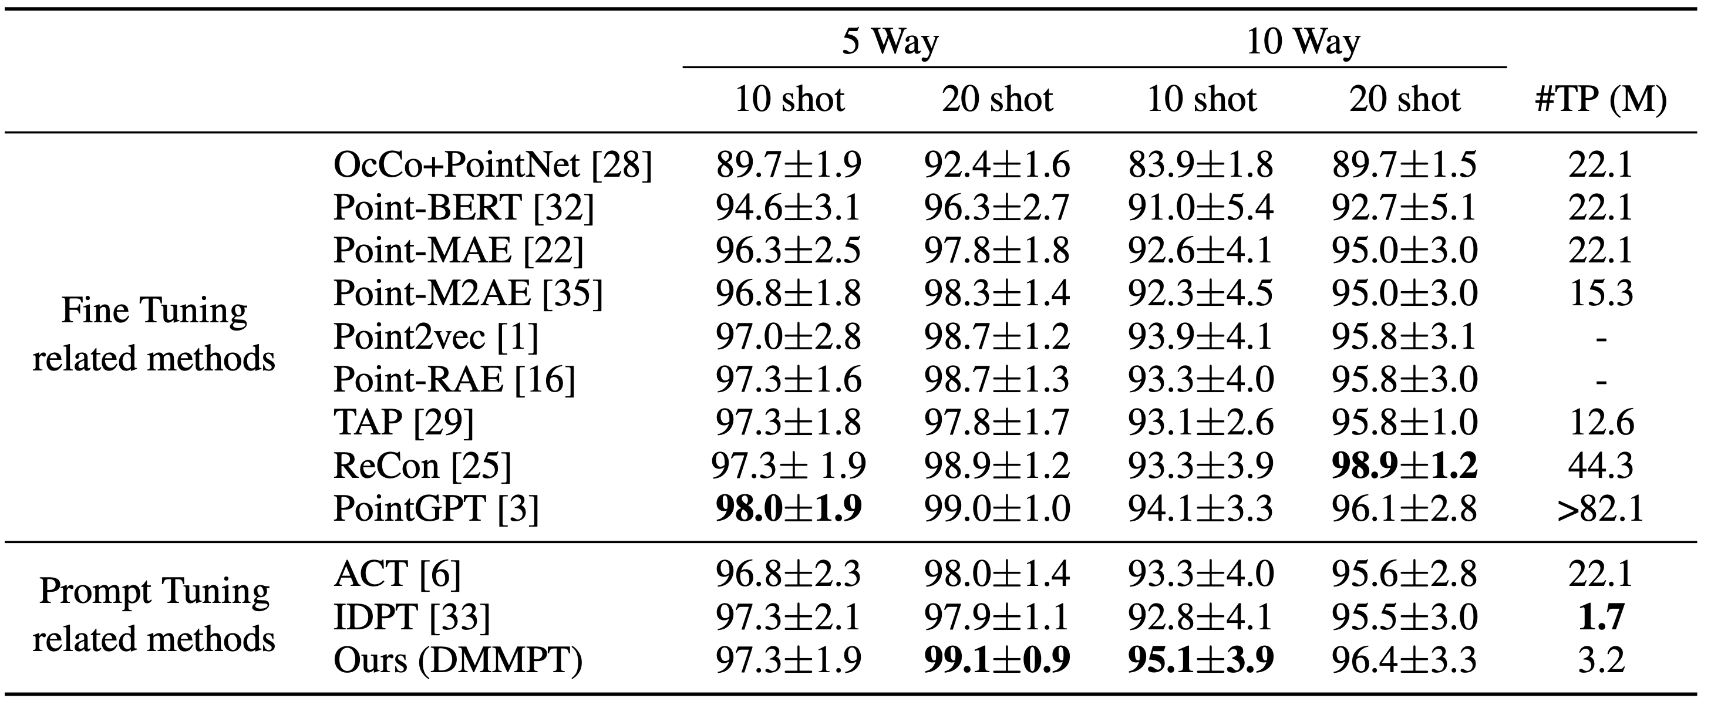
Experiments
Standard N-way K-shot few-shot learning setting.
Table 1: Comparisons with SOTA methods under Standard N-way K-shot few-shot learning on ModelNet40 benchmark dataset. We report the average classification accuracy (%) with the standard deviation (%) of 10 independent experiments. #TP (M) denotes trainable parameters(million) in models in the fine-tuning or prompt-tuning stage.

Slide 13
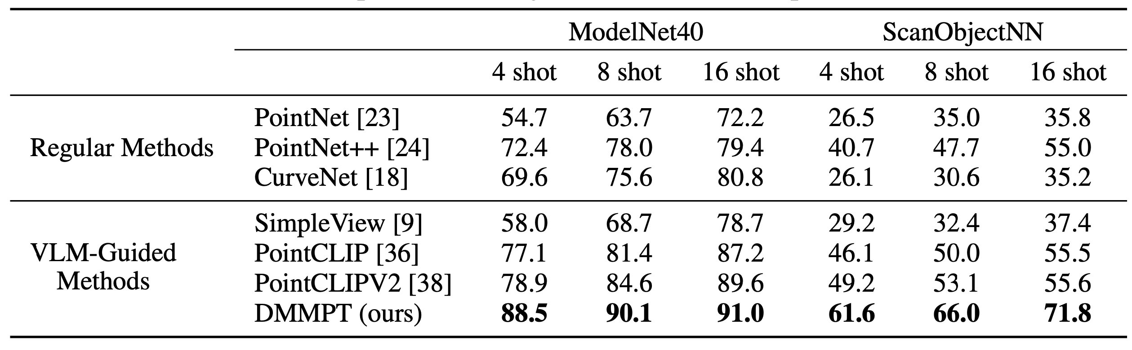
Experiments
Few-shot Learning with K-shot and All Classes
Table 2:Comparisons with typical and SOTA methods for few-shot learning under K-shot all classes on both benchmark datasets. We train and evaluate our model on ModelNet40 and PB T50 RS split of ScanObjectNN for a fair comparison.

Slide 14
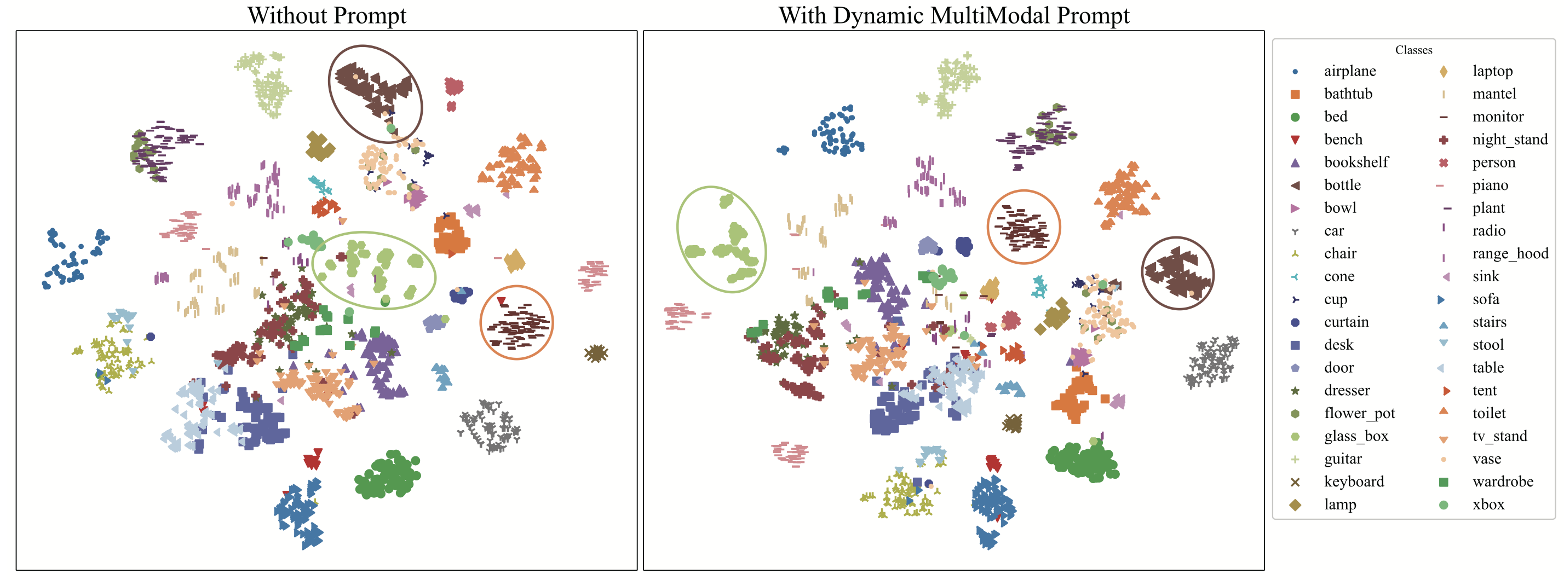
Experiments: Qualitative Analysis of DMMPT
Figure :The t-SNE visualization of point cloud features in the last layer with or without dynamic multimodal prompt tuning method. We conduct this visualization on few-shot learning with 16-shot and all 40 classes on ModelNet40. The result shows with our dynamic multimodal prompt, features become more distinctively separated.

Slide 15
Conclusion
We propose DMMPT, a new prompt tuning method for VLM-Guided point cloud models for few-shot learning. By introducing a dynamic knowledge collector capable of gathering knowledge from various modalities and creating a multimodal prompt generator to enhance knowledge sharing, we manage to fully absorb information across modalities and boost pre-trained point cloud models in few-shot learning tasks.
We evaluate our model not only in the standard N-way K-shot few-shot settings but also in a challenging setting with a larger number of classes for models to identify. This highlights the potential of our method in real-life applications.
Experiments demonstrate that our model exhibits outstanding performance in both few-shot learning settings. Our method outperforms other prompt-tuning-related methods and maintains strong competitiveness with full fine-tuning methods while significantly enhancing computational efficiency.

Slide 16



Q&A ☹
The authors are unable to be here today due to some unexpected visa issues.
We sincerely apologize for any inconvenience caused, and you can reach out to us (and our codes) through the following methods. 👇

